Slide 1
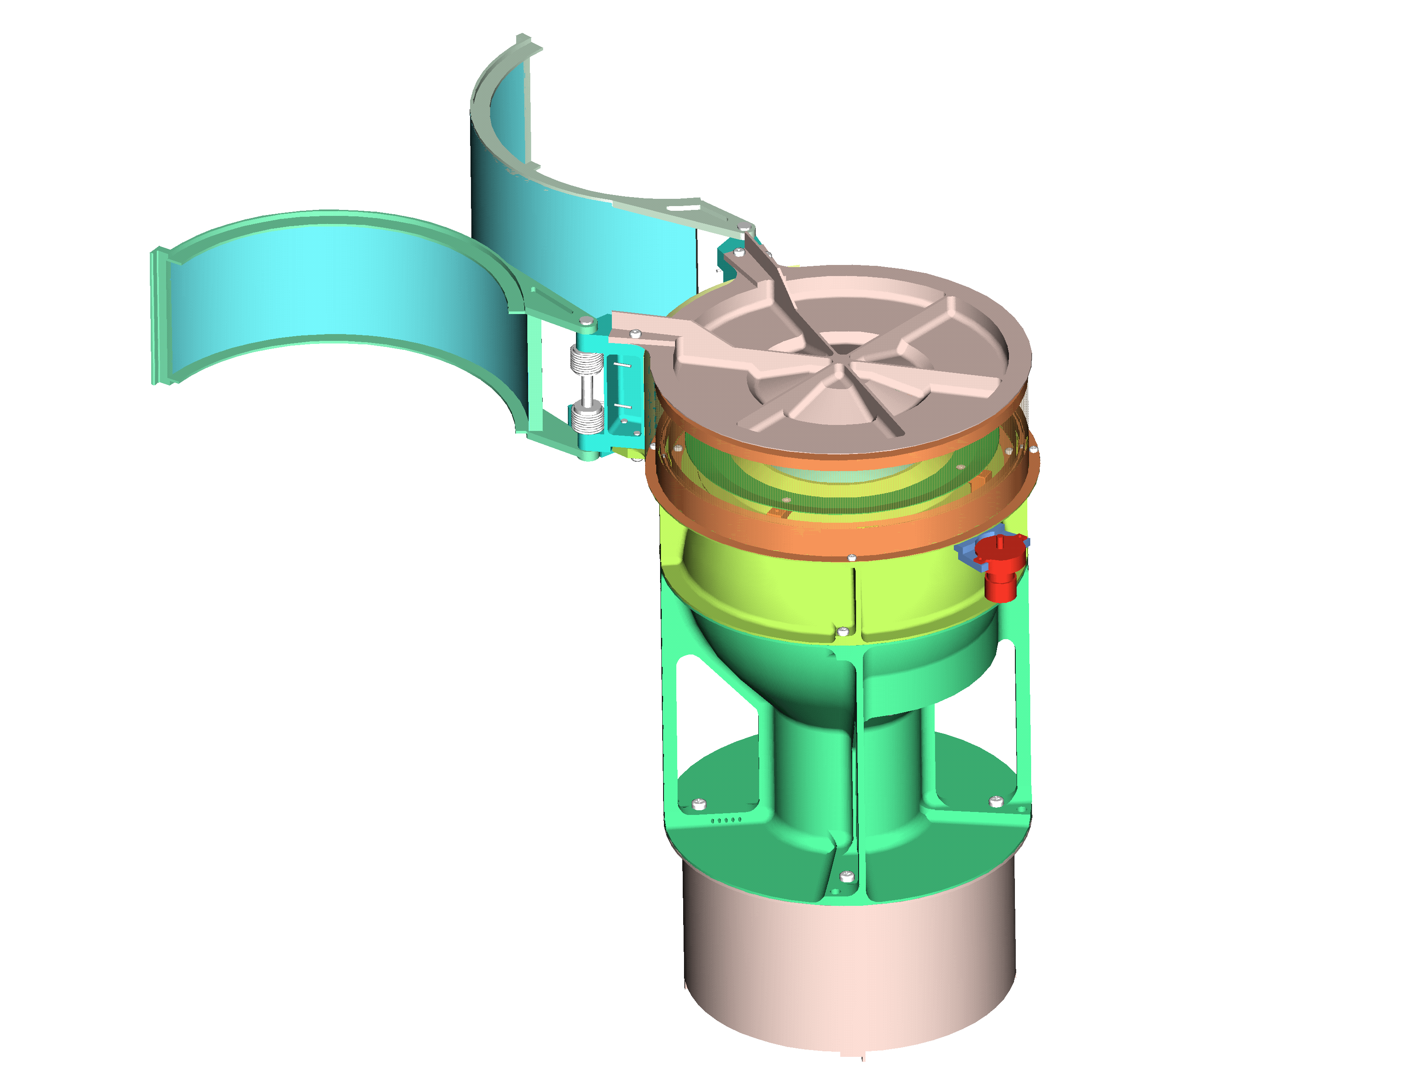
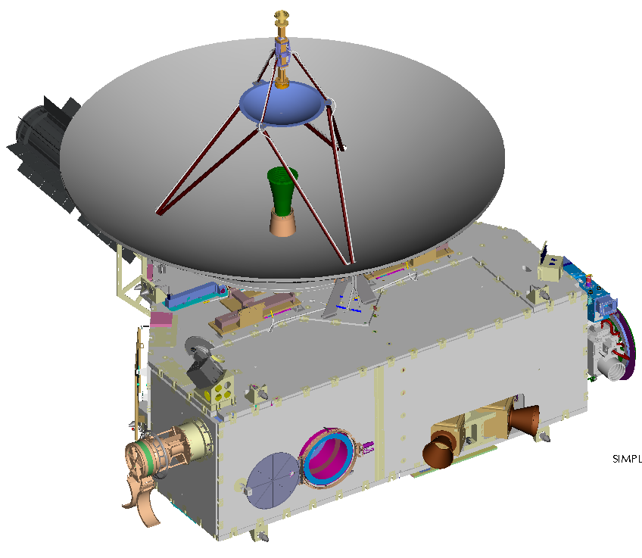
Coordinate system
New Horizons
SWAP
Definition of Angles
+Y
High Gain
Antenna
-Z
-Z
Y
+X
+X
+X
X
+Z
Z
-X
RTG
+Y
-X
ϕ
+Y
θ
+Z
SWAP
Star Trackers
The SWAP coordinate system is nearly aligned with that of the spacecraft.
Positive angles are towards positive axes.

Slide 2
New Horizons Trajectory

Slide 3
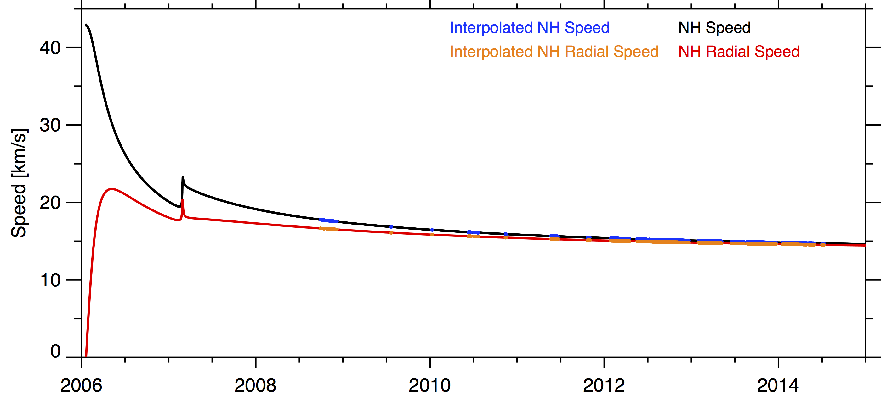
Radial Component of Spacecraft Velocity
The speed of the spacecraft is in black.
The red is the speed along the radial direction (calculation below).
In blue is the spacecraft speed interpolated to SWAP measurement time.
In orange is the spacecraft radial speed interpolated to SWAP measurement time.
Since New Horizons is moving away from the Sun the SWAP measured energy (speed) is less than it really is. To reproduce the SWAP measurements you need to lower the ion speed by radial speed of the spacecraft.

Slide 4
Comprehensive Model
The comprehensive model accounts for the transmission as a function of energy, and both angular directions, and spinning of the spacecraft.

Slide 5
Effective Area
The overall effective area is owing to the overall geometric throughput and the efficiency of the detectors. The detector efficiency is a function of time.
The launched over all effective area was published in McComas et al., 2008. It was 0.033 cm^{2.}

Slide 6
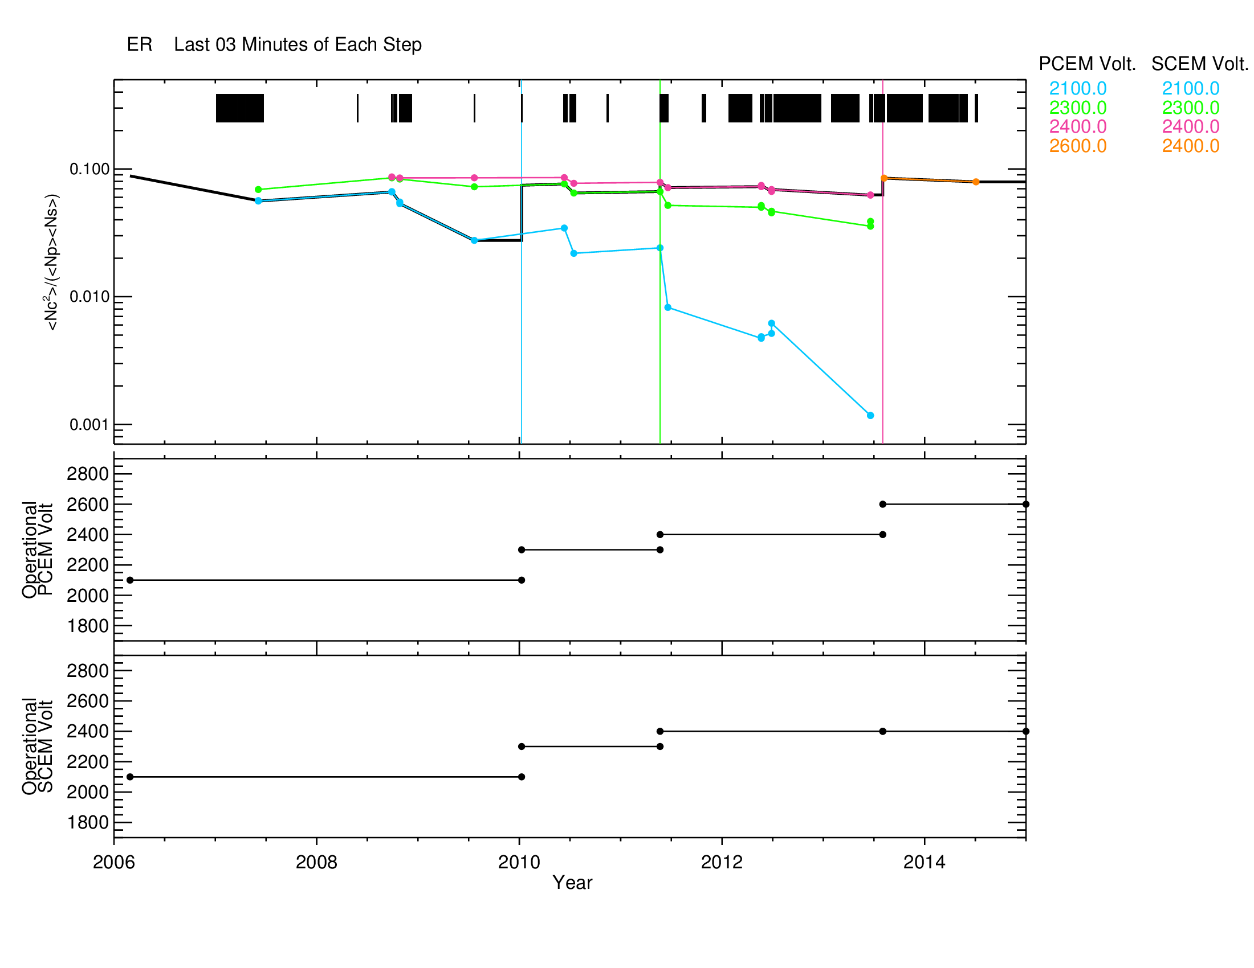
Detector Efficiency (E_{detector}) Vs Time
Detector efficiency is the coincidence rate (Nc) squared divided by the product of the primary (Np) and secondary (Ns) rates.
The top above plot shows the detector efficiency as a function of time. The black bar indicates the duty cycle of the instrument.
The efficiency points shown were taken during CEM gain tests.
The bottom plots show the CEM operation voltages.
The thick black line under the colored lines corresponds to the final lookup table values.

Slide 7
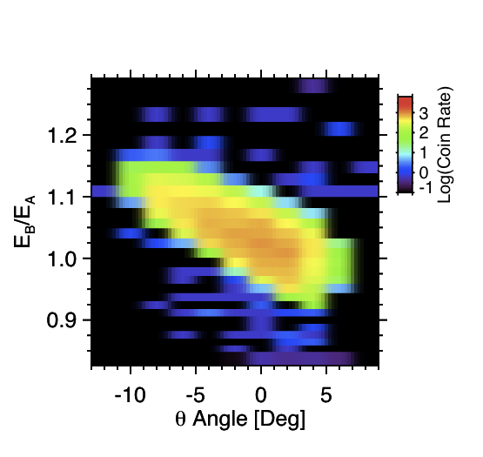
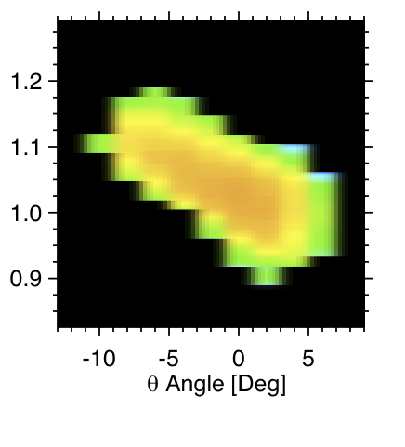
Speed-θ Response In the lab we measured
Lab Calibration
Scaled Simulation
E/Es
E/Es
In the lab we had a beam energy of 1000eV and we varied the instrument energy step (also called analyzer energy). Here the ratio of the beam energy (ambient energy E) to the energy step value (also called analyzer energy k*Voltage_ESA). Here E is 1000V, and the test was run by varing Es that is varing the ESA voltage.
We use the simulated response curves scaled to match the lab calibration at 1000 eV to charcterize the speed- θ response (w(v,θ)).
In the response file there is a 3-D array (w’(E/Es. θ,Es)) that is a set of w(E/E, θ) arrays for a given each energy step Es

Slide 8
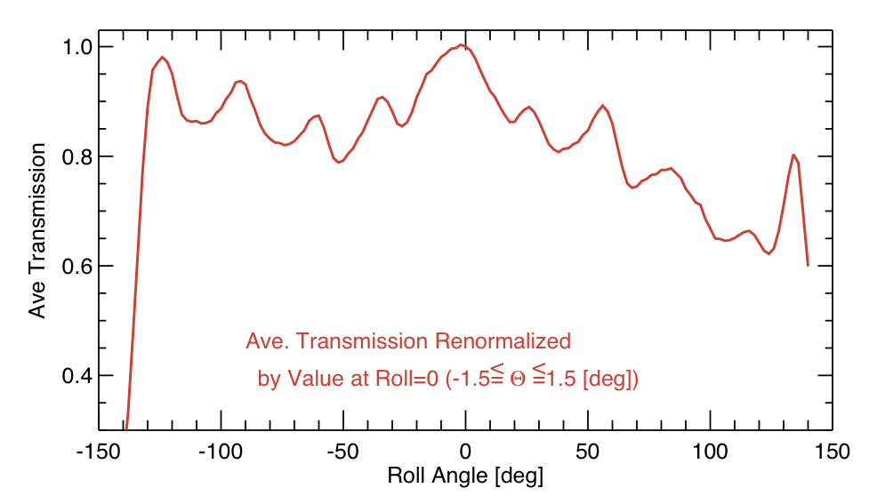
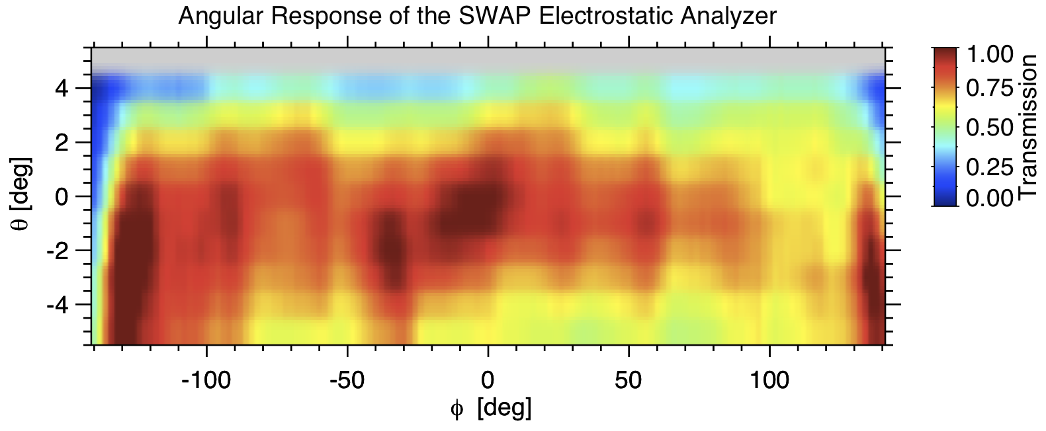
Phi Response ( )
To derive the ϕ response (shown left) we used the center of the laboratory θ and ϕ response taken with a 1000 eV beam (shown below) to characterize the ϕ angle transmission (p(ϕ)).

Slide 9
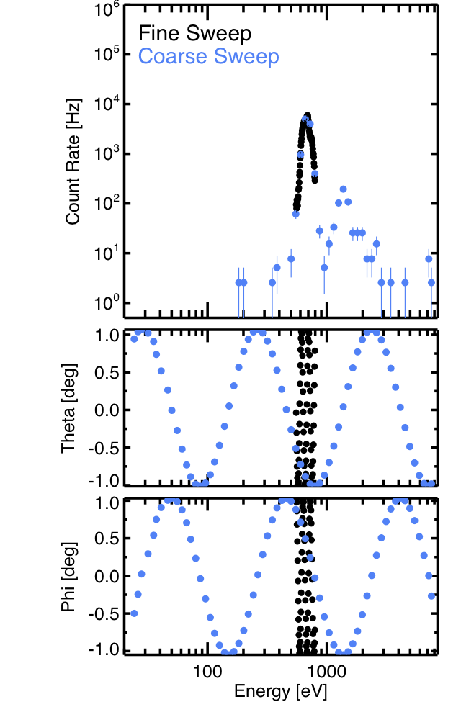
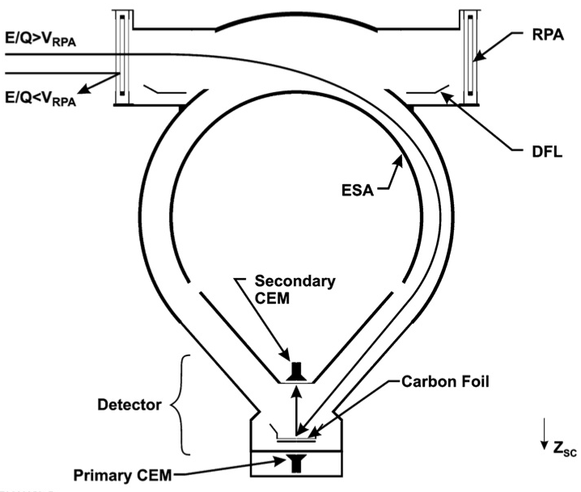
SWAP Instrument and Data
Ions that enter any where in our 10 by 276° aperture get focused onto a pair of channel electron multipliers (CEM).
Each coarse sweep has 64 steps and takes 32 sec.
Fine sweeps are centered on the peak energy found in the coarse scan and also has 64 steps taken in 32 sec.
Each step has an accumulation time of 390 msec.
_{26.96 AU}
_{08/04/2013}
H⁺
He⁺⁺

Slide 10
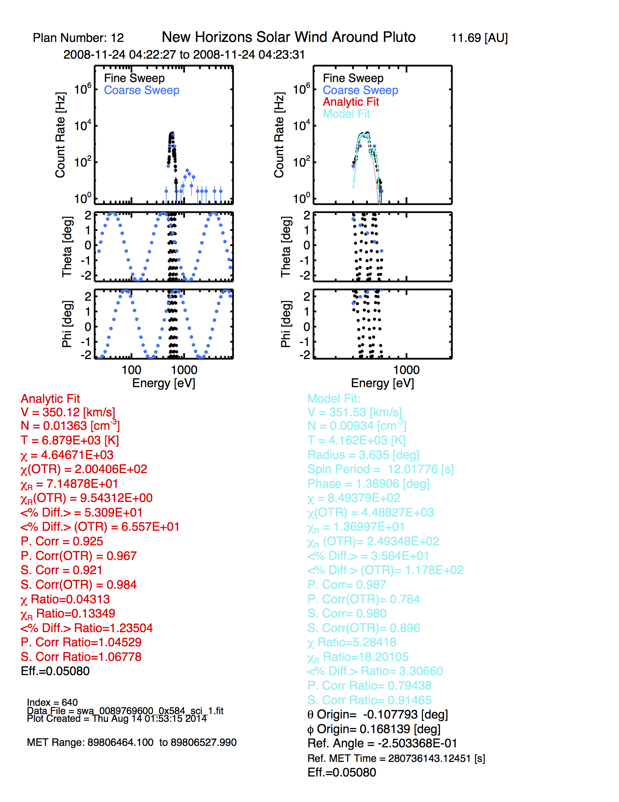
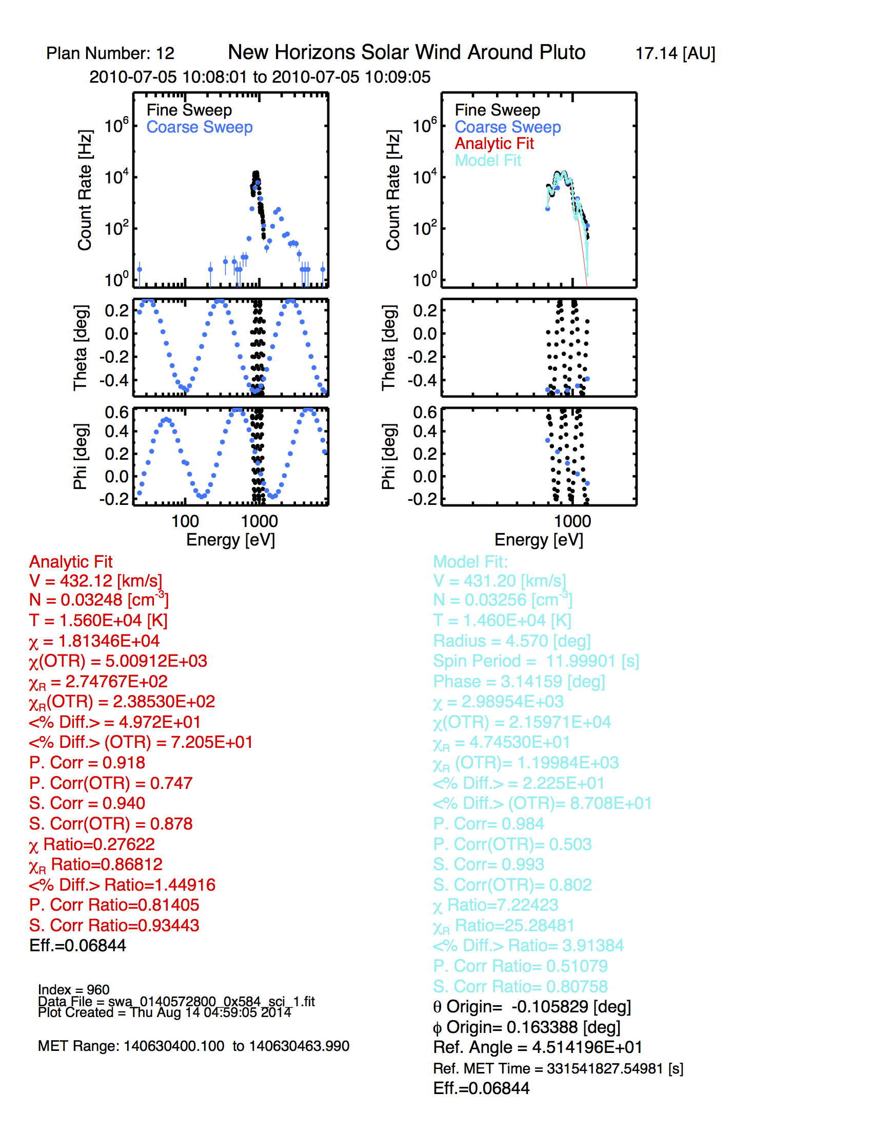
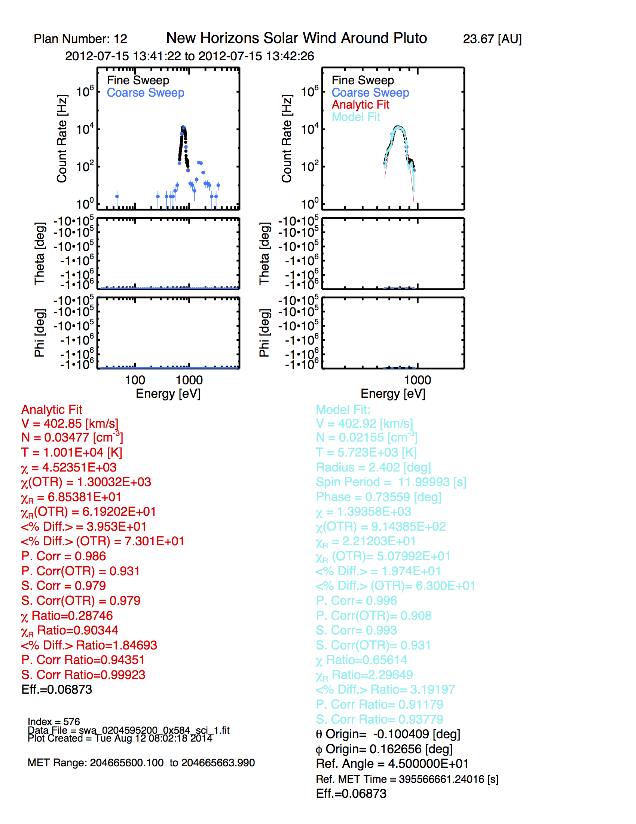

Distribution Examples at Different Distances
11.7 [AU]
17.14 [AU]
23.67 [AU]
26.95 [AU]
Hibernation
No Attitude Data
V = 352 [km/s]
N = 0.0093 [cm³]
T = 4162 K
V = 431 [km/s]
N = 0.0326 [cm³]
T = 14,600 K
V = 403 [km/s]
N = 0.0255 [cm³]
T = 5723 K
V = 372 [km/s]
N = 0.0119 [cm³]
T = 22,340 Ks
Note the small local peaks are vary with the theta and phi angles.
The bumps are why we need to account for the angle variations in the instrument response.

Slide 11
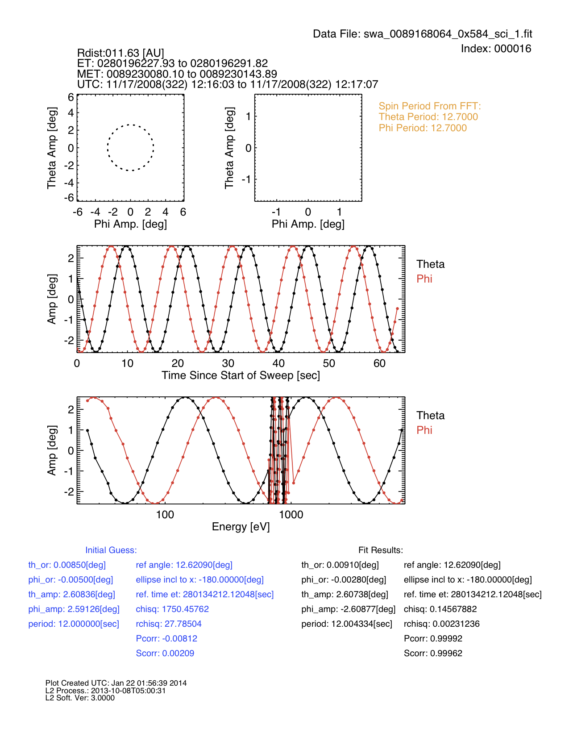
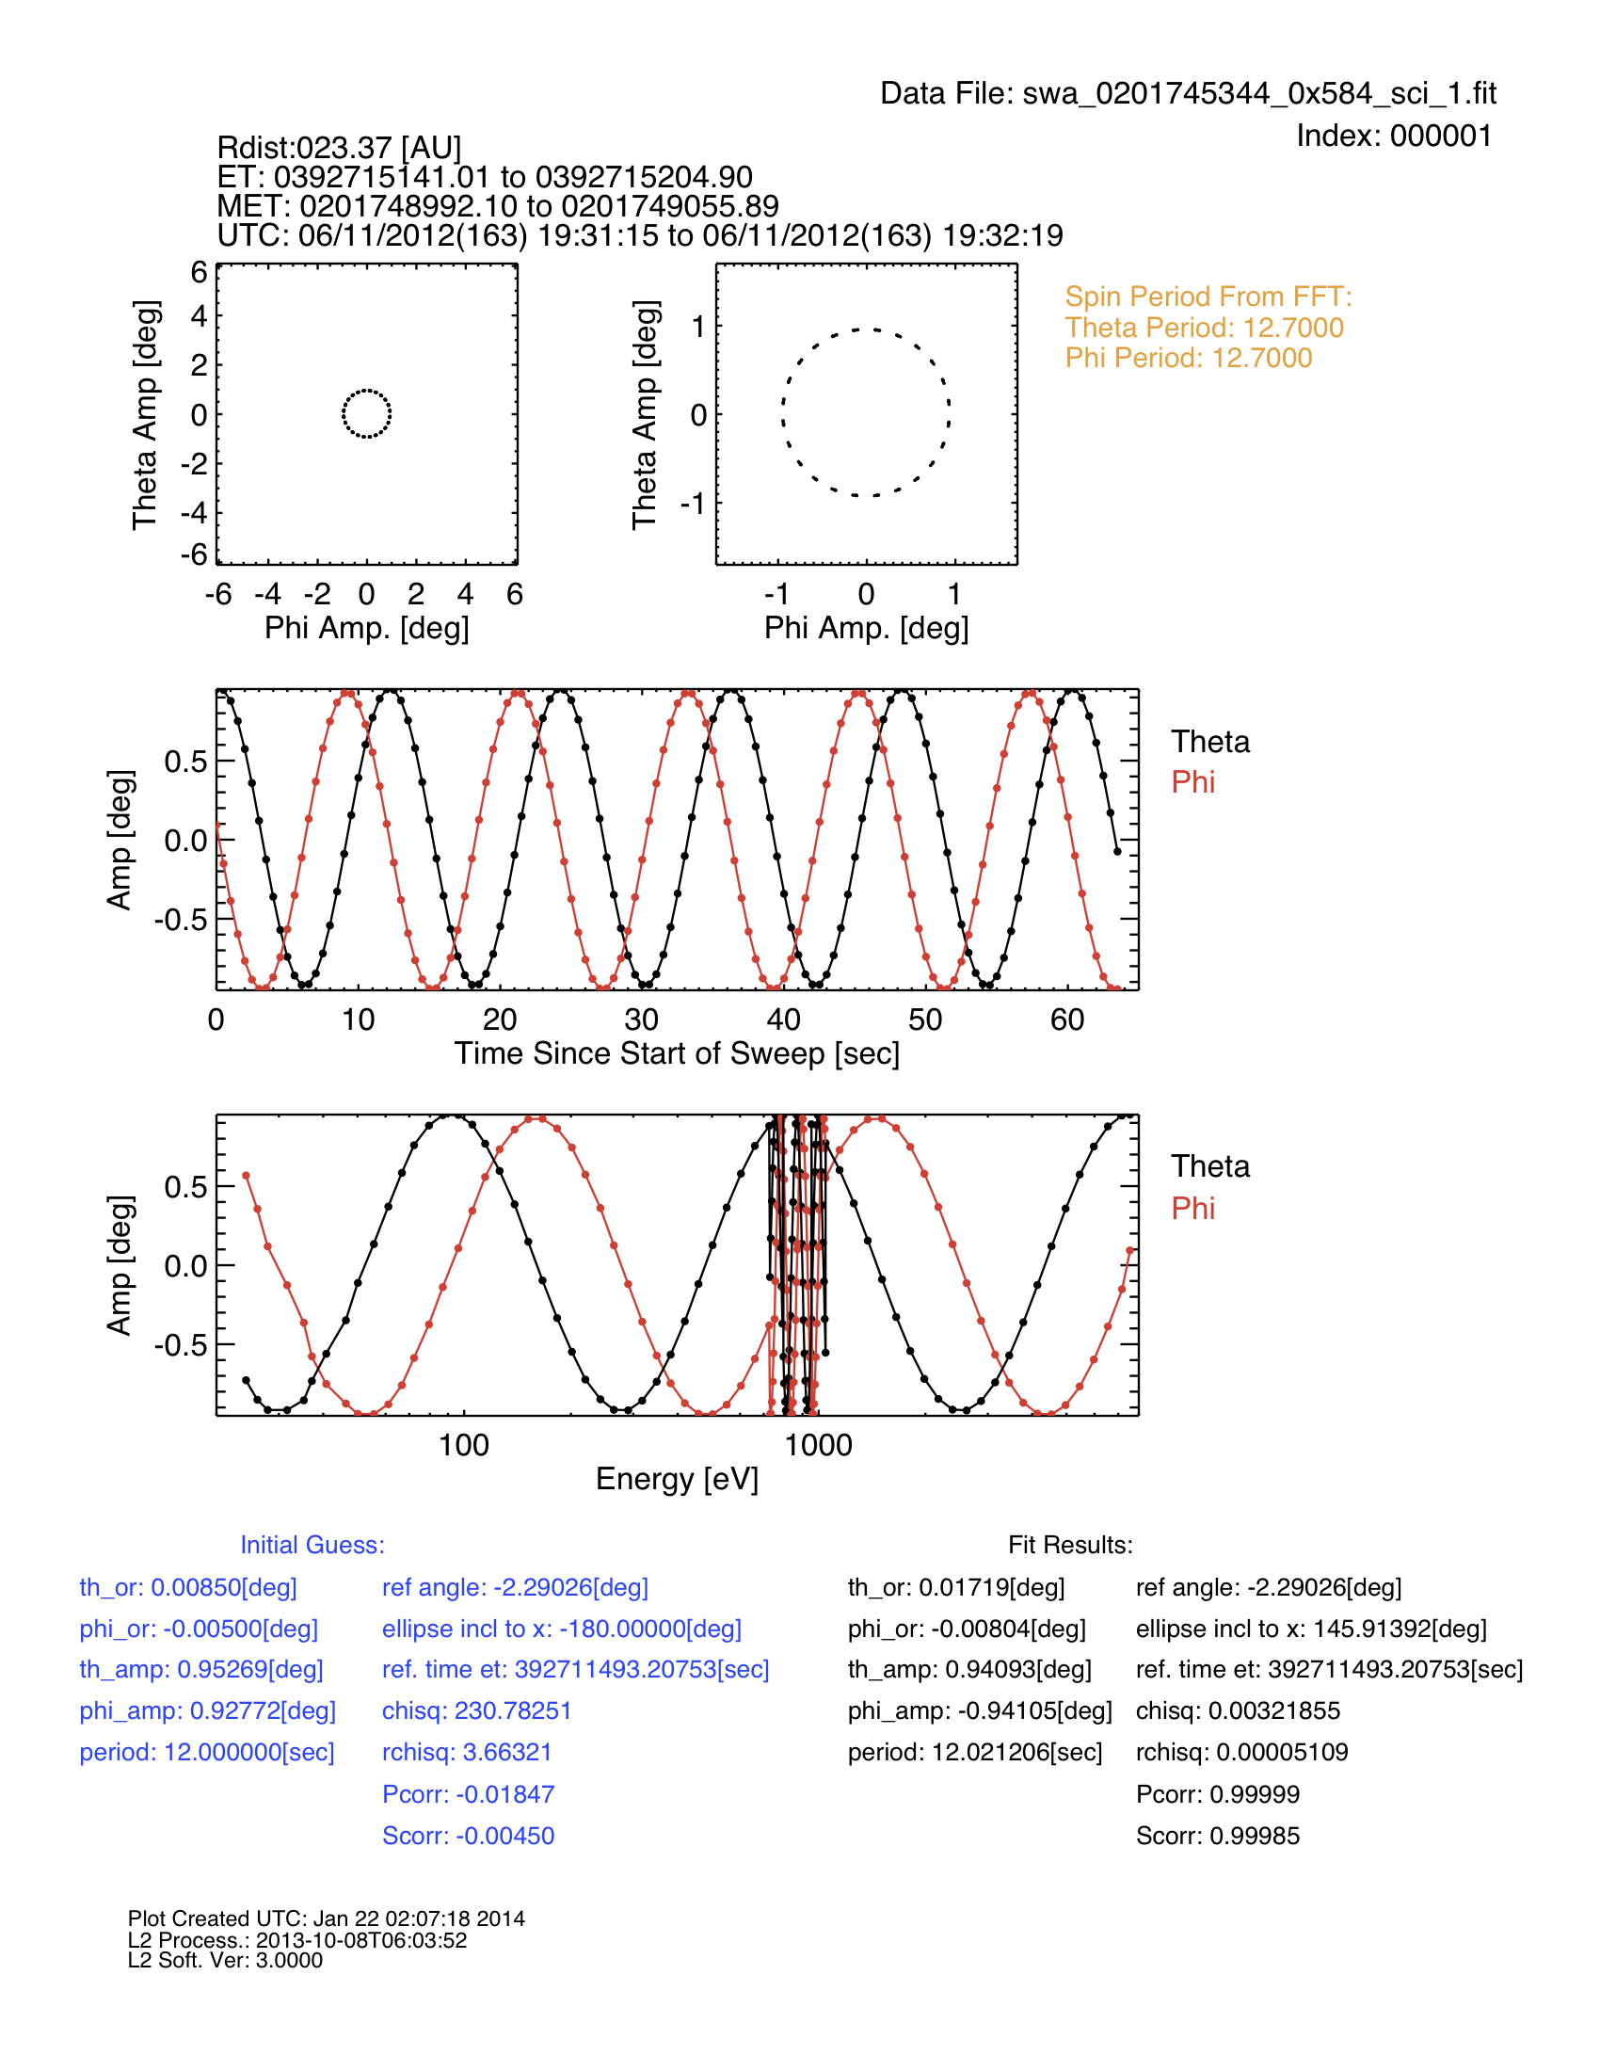
Examples of Fitting Measured Sun Angles as Coupled Set of Ellipse Equations

Slide 12
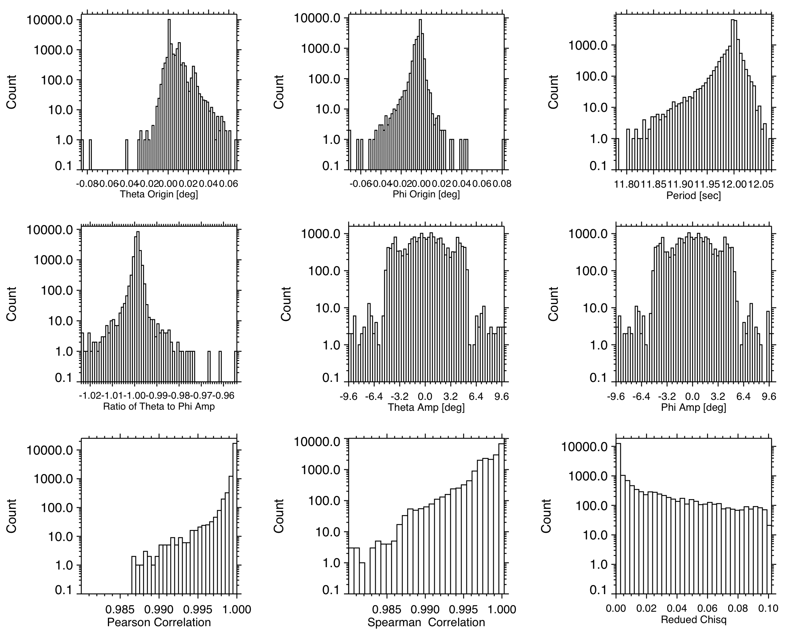
Distributions of Sun Angle Fit Results:
Origin
θ
Origin
ϕ
Rotation
Period
Ratio of
θ to ϕ
Amp.
Amp.
θ
Amp.
ϕ
Pearson Corr.
Spearman Corr.
Reduced Chi
Shown here are all the spinning intervals with rotation periods from 11-13 seconds and the ellipse fitting worked well.
Reduced Chi < 0.1
Pearson Correlation >0.98
Spearman Correlation >0.98

